Slide 1

Department of Computer Science and Engineering -AI
THEME NO: 03
Adaptive Video Streaming & Buffer Management Engine
S1 Functional Requirements Engineering
TEAM NO:14
Sl.no | Name | Roll.no | USN
1. | Divya Kumari | 222 | 01FE24BCI094
2. | Akshay Bhat | 210 | 01FE24BCI024
3. | Renuka Kagadal | 243 | 01FE24BCI119
4. | B Bhagyashree | 231 | 01FE24BCI104
Guide: Amit Kachavimath , Department of CSE-AI

Slide 2
Proposed Engine Summary
ID | Engine Name | Major Course | Primary Responsibility | Owner
E1 | Network Condition & Communication | Computer Networks | Process bandwidth traces; TCP socket communication; carry chunk requests and data; Handle timeouts and retries | Divya Kumari
E2 | Video Segmentation & Chunk Delivery | Computer Networks, Data Structures, DBMS | Split video into chunks; Multiple bitrate versions; Store chunk metadata; provide requested chunks through TCP sockets | Renuka Kagadal
E3 | Throughput Estimation & ABR Decision | Data Structures & Algorithms | Measure chunk download time; Estimate throughput; Run the selected ABR algorithm; Select next chunk bitrate | Akshay Bhat
E4 | Priority Scheduling ,& Concurrent Resource Management Engine | Operating Systems | Schedule client requests by Gold/Silver priority without starvation, run them on a bounded worker pool, and keep the shared queues, chunk cache and playback buffer consistent and within configured limits. | B Bhagyashree

Slide 3
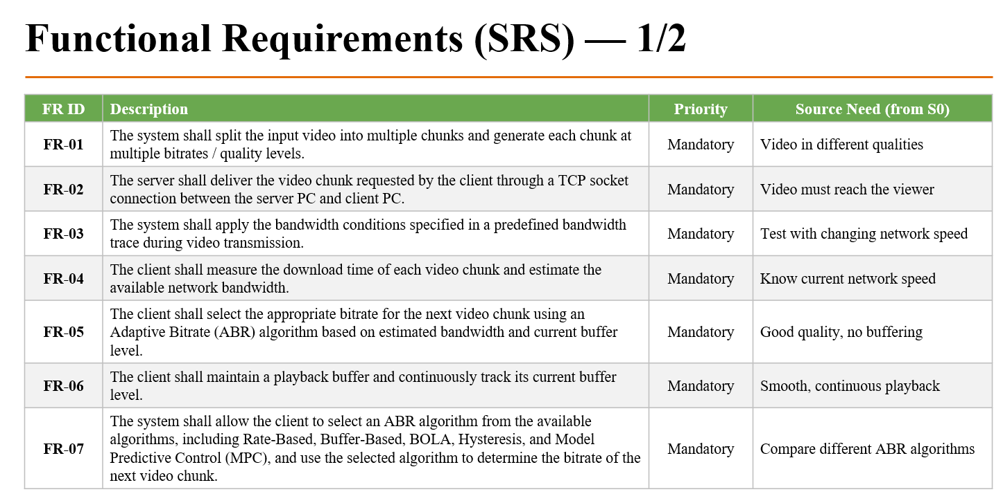

Slide 4
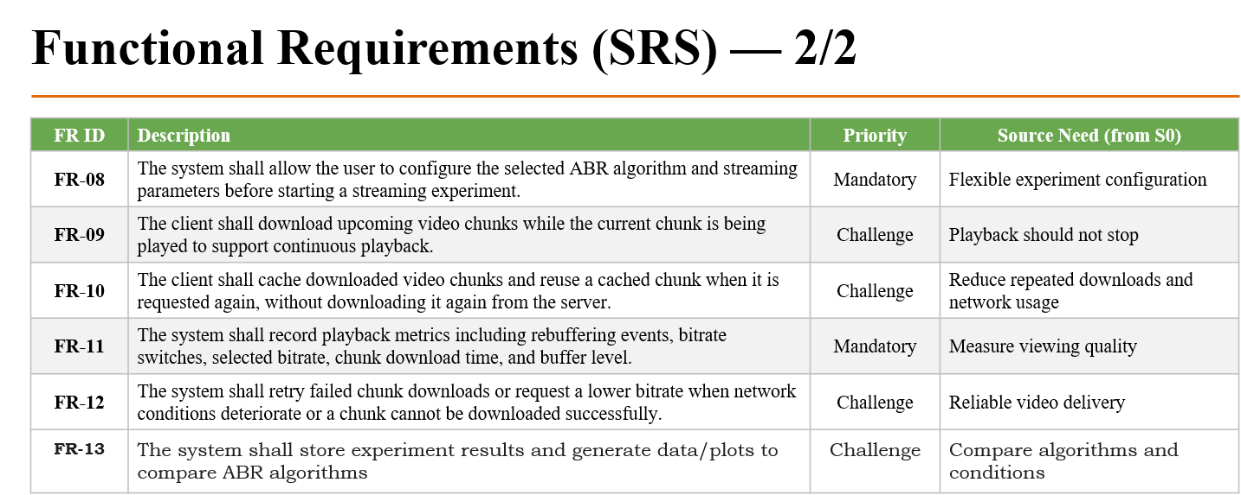

Slide 5
Non-Functional Requirements (SRS)
NFR ID | Category | Requirement | Measurable Target
NFR1 | Performance | The system shall minimize video buffering during playback. | Rebuffering ratio ≤ 5% of playback time
NFR2 | Accuracy | The system shall provide accurate estimation of the available network bandwidth | Estimation error ≤ 20% of actual bandwidth
NFR3 | Reliability | The system shall provide reliable video streaming without unexpected application termination or unrecovered connection failure. | ≥ 95% of sessions complete successfully
NFR4 | Quality | The system shall maintain stable video quality and minimize frequent bitrate changes.. | No more than 6 bitrate switches per minute
NFR5 | Resource usage | The system shall use system resources efficiently during video streaming. | Buffer ≤ 30 s of video; cache within configured limit
NFR6 | Responsiveness | The system shall respond to changes in network conditions without significantly affecting playback quality. | Bitrate adjusts within 3 chunks of a big bandwidth change
NFR7 | Maintainability | The system shall maintain a modular structure so that individual components can be independently tested and maintained. | Networking, ABR, buffer, cache, playback, QoE modules separately testable
NFR8 | Extensibility | The system shall allow new ABR algorithms to be integrated without modifying the core streaming components. | New ABR needs ≤ 2 dedicated modules
NFR9 | Reproducibility | The system shall produce consistent results when the same experiment is repeated under equivalent conditions. | QoE varies ≤ ±5% across 3 runs
NFR10 | Usability & integrity | The system shall provide accurate and understandable monitoring of streaming experiments. | ≥ 99% of download events logged; live buffer graph

Slide 6
Use Cases / User Stories
ID | Actor | User Story | Exception Flow
UC1 | Developer | As a developer, I want the video split into chunks at multiple bitrates so that the client can switch quality during streaming. | Missing or corrupt chunk: flagged and regenerated
UC2 | Viewer | As a viewer, I want the video to start quickly after I press play so that I don't have to wait. | Server unreachable: retry, then show error
UC3 | Viewer | As a viewer, I want the quality chosen automatically so that I never have to adjust it manually. | Noisy or missing reading: use last value or lowest quality
UC4 | Viewer | As a viewer, I want the next chunk downloaded while the current one plays so that playback is smooth. | Buffer empty: pause, log stall, resume after refill
UC5 | Viewer | As a viewer, I want quality to drop automatically when the network slows so that the video keeps playing. | Buffer still empties: rebuffer, then resume
UC6 | Viewer | As a viewer, I want quality to stay steady during small network changes so that it doesn't keep flickering. | Rapid oscillation: switch-limit rule prevents thrashing
UC7 | Video Server | As the video server, I want to deliver the exact chunk requested so that playback continues in order. | Chunk not found or timeout: return error, client retries or lowers quality
UC8 | Video Server | As the video server, I want to handle several viewers at once so that one viewer doesn't slow down others. | Overload: slower responses, load recorded
UC9 | Tester | As a tester, I want to replay a changing network and run stress tests so that I can check behaviour under bad conditions. | Invalid or empty trace: reject with a message
UC10 | Tester | As a tester, I want to see KPIs and a live buffer graph so that I can judge streaming performance. | Incomplete log: report flags the gap

Slide 7
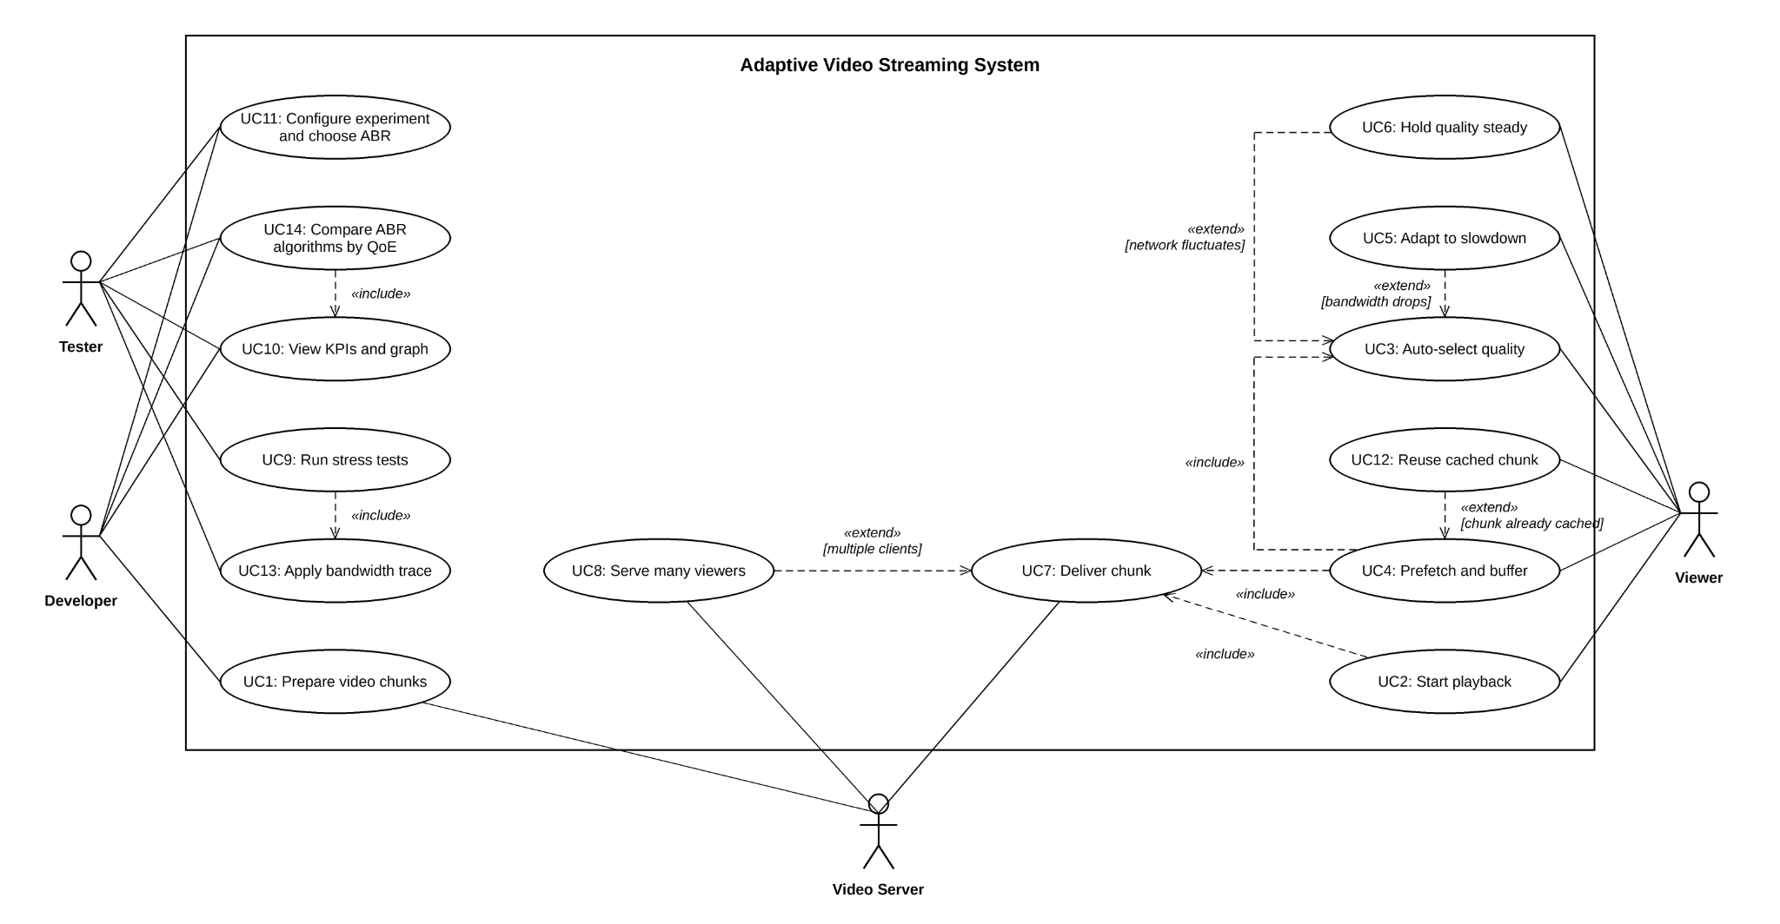
Use Case Diagram

Slide 8
Requirement Priority
Mandatory
Challenge / Stretch
FR-01 to FR-13: TCP server, multi-bitrate chunks, Gold/Silver scheduling, cache, worker pool, ABR, buffer, playback control, metrics, comparison
NFR-01 Concurrency (≥ 10 clients)
NFR-02 Latency (median, p95)
NFR-03 Fairness
NFR-04 Cache efficiency
NFR-05 Client QoE
NFR-06 Resource limits
NFR-07 Synchronization
NFR-08 Reliability
NFR-10 Measurability (≥ 3 runs)
NFR-09 Scalability (1, 5, 10 clients)

Slide 9
Requirement Clustering Sheet
Cluster ID | Cluster / Responsibility Area | Requirement IDs | Common Technical Responsibility | Engine
C01 | Network Condition & Communication (Computer Networks) | FR-02, FR-03, FR-09, NFR-05 | Manage network conditions and reliable client-server chunk communication | E1 – Network & Communication
C02 | Video Segmentation & Chunk Delivery (Computer Networks, Data Structures, DBMS) | FR-01, FR-04 | Prepare, organize and provide video chunks at multiple quality levels | E2 – Segmentation & Chunk Delivery
C03 | Throughput Estimation & ABR Decision (Data Structures & Algorithms) | FR-04, FR-05, FR-06, FR-07, FR-08, NFR-01, NFR-05, NFR-07 | Estimate throughput and select the appropriate bitrate using ABR | E3 – Throughput Estimation & ABR Decision
C04 | Playback Buffer & Performance (Operating Systems, DBMS) | FR-09, FR-10, FR-11, FR-12, FR-13, FR-14, NFR-08, NFR-09 | Manage playback buffer, caching, playback continuity and performance/QoE measurement | E4 – Playback Buffer & Cache Management

Slide 10
Engine 01: Network & Communication
Owner: Divya Kumari (01FE24BCI094) | Requirements: C1 — FR2, FR3, FR9, NFR5
A. Purpose
Manages network communication between the server PC and client PC using TCP sockets
Processes the bandwidth trace to control the transmission rate
Handles connection failures, timeouts and retries
B. Responsibility and boundary
Owns: trace processing, rate control, TCP communication, chunk request/transfer, timeout and retry handling, network logging
Does not own: chunk generation (E2), ABR selection (E3), buffer management (E4)
C. Inputs, outputs and state
In: bandwidth trace, chunk request, TCP connection request, start/stop
Out: current rate condition, chunk to client, transfer status, error/timeout info
State: bandwidth value, trace position, active connection
D. Core mechanism
Trace playback: set allowed speed per time step and slow sending to match
Request/reply over sockets with timeout and retry
E. KPIs
Chunk delivery success ≥ 99%
Bitrate adjustment within 3 chunks
Recovery rate ≥ 95%; valid traces load 100%

Slide 11
Engine 02: Segmentation & Chunk Delivery
Owner: Renuka Kagadal (01FE24BCI119) | Requirements: FR-1, FR-3, FR-4
A. Purpose
Prepares video for adaptive streaming by dividing it into small chunks with multiple quality versions
Maintains chunk number, quality, bitrate, duration and size
Provides the requested chunk to the streaming system
B. Responsibility and boundary
Prepare and manage video chunks for streaming
Owns: segmentation, quality/bitrate versions, chunk metadata, chunk identification, chunk retrieval
C. Inputs, outputs and state
In: video file, quality levels, chunk duration, chunk request
Out: required chunk and its metadata
State: chunk files, number, quality, bitrate, duration, size
D. Core mechanism
Fixed-duration segmentation (FR-01)
Multi-quality / bitrate generation (FR-01)
Chunk metadata management (FR-04)
Chunk lookup and retrieval (FR-03)
E. Failure handling and KPIs
E1 transfer failure: return error, allow retry; success ≥ 95%
Missing or invalid chunk: detect and report; ≥ 99% available
Quality unavailable: nearest quality; valid quality delivered

Slide 12
Engine 03: Throughput Estimation & ABR Decision
Owner:Akshay Bhat (01FE24BCI024) | Requirements:FR-04, FR-05, FR-06, FR-07, FR-08, NFR-01, NFR-05, NFR-07
A. Purpose
• Estimates network throughput from video chunk
download behaviour
• Uses throughput and playback-buffer information to make adaptive bitrate decisions
• Selects an appropriate quality/bitrate for the next video chunk
• Helps balance video quality and continuous playback under changing network conditions.
B. Responsibility and boundary
• Estimates current network throughput
• Runs the selected ABR algorithm for quality selection
• Owns throughput measurements, estimates and ABR decision state
• Does not own network communication, video segmentation, or playback-buffer management
C Inputs, outputs and state
• In: Chunk download time, chunk size, current buffer level, previous quality/throughput
• Out: Estimated throughput and selected bitrate/quality for the next chunk
• State: Recent throughput measurements, current throughput estimate, selected quality and ABR configuration
D. Core mechanism
• Download-time based throughput estimation
• Throughput smoothing using EWMA
• ABR quality selection using throughput and buffer level
• Quality adaptation based on changing network conditions
E. Failure handling and KPIs
• Noisy/unstable throughput: use smoothed throughput for stable decisions
• Low buffer / bandwidth drop: select a safer lower bitrate
• Invalid/missing measurement: use the latest valid estimate or conservative quality
• KPI: Throughput estimation error ≤ 20%
• KPI: ABR decision ≤ 500 ms
• KPI: Quality adjustment within 3 chunks after significant network change

Slide 13
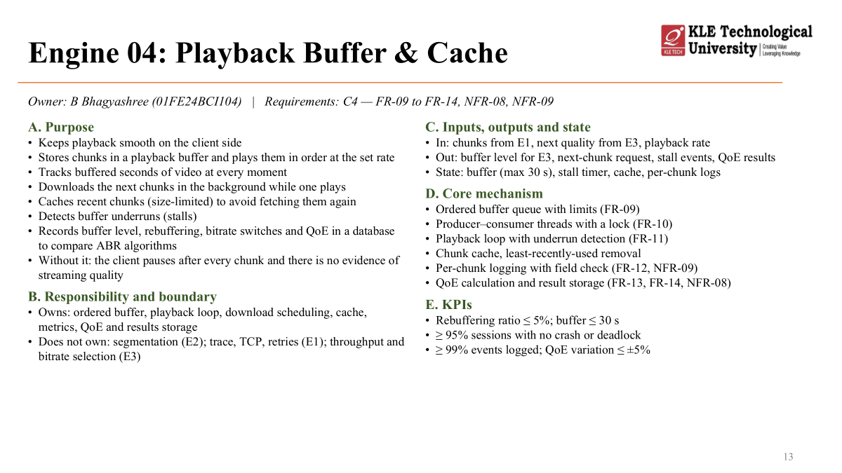
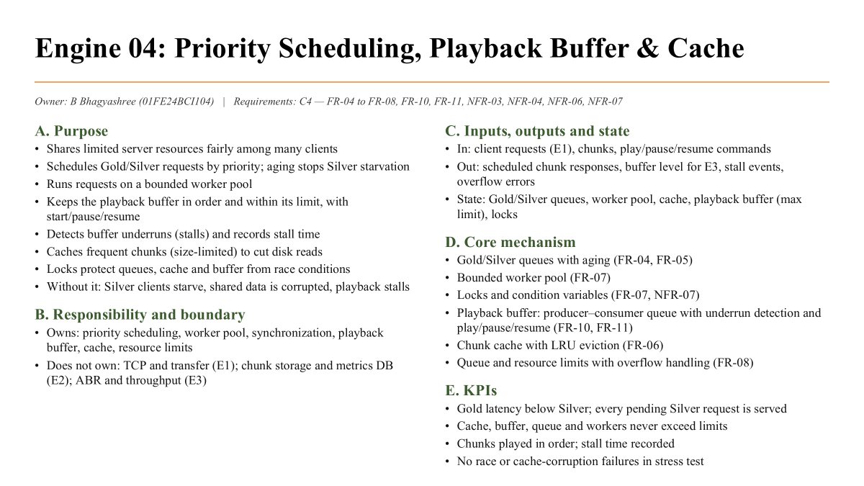
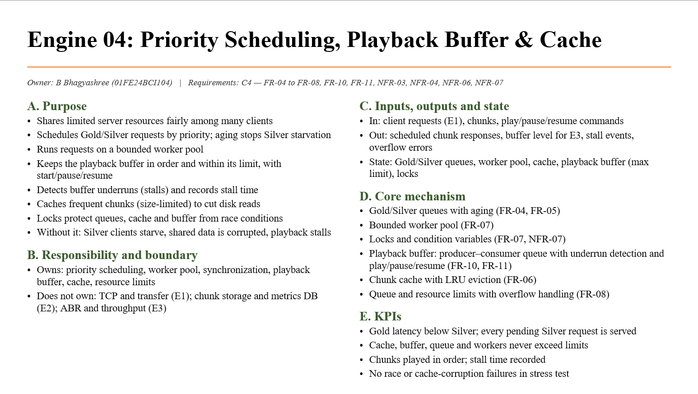
Engine 04: Playback Buffer & Cache
Owner: B Bhagyashree (01FE24BCI104) | Requirements: C4 — FR-09 to FR-14, NFR-08, NFR-09
A. Purpose
B. Responsibility and boundary
Keeps playback continuous and measurable: buffer, background downloads, chunk cache, QoE results in a database
Owns: ordered buffer and level tracking; playback loop and underrun detection; download scheduling; cache with size limit; metrics, QoE, results storage
Does not own: segmentation (E2); trace, TCP, retries (E1); throughput and bitrate selection (E3)
C. Inputs, outputs and state
In: chunks from E1, next quality from E3, playback rate
Out: buffer level for E3, next-chunk request, stall events, QoE results
State: buffer (max 30 s), stall timer, cache, per-chunk logs
D. Core mechanism
Ordered buffer queue with limits (FR-09)
Producer–consumer threads with a lock (FR-10)
Playback loop with underrun detection (FR-11)
Chunk cache, least-recently-used removal
Per-chunk logging with field check (FR-12, NFR-09)
QoE calculation and result storage (FR-13, FR-14, NFR-08)
E. KPIs
Rebuffering ratio ≤ 5%; buffer ≤ 30 s
≥ 95% sessions with no crash or deadlock
≥ 99% events logged; QoE variation ≤ ±5%

Slide 14



